Slide 1
Subject: Programming in Python Part-3 CSE3&IT
Neha Chadha
IT Department
1

Slide 2
Object Oriented Programming
Class − A user-defined prototype for an object that defines a set of attributes that characterize any object of the class. The attributes are data members (class variables and instance variables) and methods, accessed via dot notation.
Class variable − A variable that is shared by all instances of a class. Class variables are defined within a class but outside any of the class's methods.
Data member − A class variable or instance variable that holds data associated with a class and its objects.
Instance variable − A variable that is defined inside a method and belongs only to the current instance of a class.
Inheritance − The transfer of the characteristics of a class to other classes that are derived from it.
Method − A special kind of function that is defined in a class definition.
Object − A unique instance of a data structure that's defined by its class. An object comprises both data members (class variables and instance variables) and methods.

Slide 3
Creating Classes
The class statement creates a new class definition. The name of the class immediately follows the keyword class followed by a colon
The class has a documentation string, which can be accessed via ClassName.__doc__.
The class_suite consists of all the component statements defining class members, data attributes and functions.

Slide 4
Syntax of Class
class ClassName:
'Optional class documentation string'
class_suite

Slide 5
class cal:
"this is a class"
pass
c=cal()
print(c)
Output
<__main__.cal object at 0x00206CD0>

Slide 6
Objects
Objects are mutable. The state of object can be changed at any point of time by making changes to its attributes.
Objects are used to access attributes and methods of class.

Slide 7
Accessing Attributes
You access the object's attributes using the dot operator with object.
Other methods
The getattr(obj, name[, default]) − to access the attribute of object.
The hasattr(obj,name) − to check if an attribute exists or not.
The setattr(obj,name,value) − to set an attribute. If attribute does not exist, then it would be created.
The delattr(obj, name) − to delete an attribute.

Slide 8
Accessing Attributes
class student():
def __init__(self,name,age=2):
self.name=name
self.age=age
obj=student(“Mary")
print(obj.name) Mary
print(obj.age) 2
print(getattr(obj,'age')) 2
print(hasattr(obj,'age')) True
setattr(obj,'name','Zara')
print(obj.name) Zara
(delattr(obj,'age'))
print(hasattr(obj,'age')) False

Slide 9
Create class to find sum of two numbers
class cal:
"this is sum"
def sum(a,b) :
c=a+b
return c
a=cal()
n1=int(input("enter number1"))
n2=int(input("enter number2"))
print(a.sum(n1,n2))

Slide 10
Execution on Shell
enter number12
enter number23
Traceback (most recent call last):
File "C:\Users\ASUS\Desktop\python programs\class.py", line 9, in <module>
print(a.sum(n1,n2))
TypeError: sum() takes 2 positional arguments but 3 were given

Slide 11
Class with Self
class cal:
"this is sum"
def sum(self,a,b):
c=a+b
return c
a=cal()
n1=int(input("enter number1"))
n2=int(input("enter number2"))
print(a.sum(n1,n2))

Slide 12
class cal:
"this is sum"
def sum(self,a,b):
c=a+b
return c
self=cal()
n1=int(input("enter number1"))
n2=int(input("enter number2"))
print(self.sum(n1,n2))

Slide 13
Create class to find area of rect and cir of circle
class rect():
def area(self,l,b):
return(l*b)
def cir(self,r):
return (2*3.14*r)
r1=rect()
l=int(input("l"))
b=int(input("b"))
print(r1.area(l,b))
r=int(input("radius"))
print(r1.cir(r))

Slide 14
class xyz:
def sum(self,a,b):
c=a+b
return c
c1=xyz()
n1=int(input())
n2=int(input())
print(c.sum(c1,n1,n2))

Slide 15
Self
It is not a keyword in python
In the init method, self refers to the newly created object
in other class methods, it refers to the instance whose method was called.

Slide 16
__init__
The first method __init__() is a special method, which is called class constructor or initialization method that Python calls when you create a new instance of this class.

Slide 17
When objects are instantiated, the object itself is passed into the self parameter.
class student():
def __init__(self,name,age):
self.name=name
self.age=age
obj=student("neha",2)
print(obj.name)
print(obj.age)

Slide 18
class con:
name="n"
age=0
def __init__(self,age):
self.age=age
def print1(self):
print(self.name)
print(self.age)
Output
c1=con(9)
c1.print1() n 9
print(con.age) 0

Slide 19
Create class student to enter data
class studentdata():
def getdata(self):
self.name=input("name")
self.age=input("age")
def putdata(self):
print(self.name)
print(self.age)
s=studentdata()
s.getdata()
s.putdata()

Slide 20
Create class has two methods. First method accept a string from the user, Second method print the string in upper case

Slide 21
class IOString():
def get_String(self):
self.str1 = input()
def print_String(self):
print(self.str1.upper())
str1 = IOString()
str1.get_String()
str1.print_String()

Slide 22
Access Class variable
class abc:
a=10
def cal(self):
print(a)
obj=abc()
print(obj.cal())
Traceback (most recent call last):
File "C:/Users/ASUS/Desktop/python programs/class5.py", line 6, in <module>
print(obj.cal())
File "C:/Users/ASUS/Desktop/python programs/class5.py", line 4, in cal
print(a)
NameError: name 'a' is not defined

Slide 23
Global variable access using class
a=100
class abc:
a=10
def cal(self):
print(a)
obj=abc()
(obj.cal())
Output
100

Slide 24
Access class var using object
class abc:
a=1000
pass
obj=abc()
print(obj.a)

Slide 25
Destructor
A class can implement the special method __del__(), called a destructor, that is invoked when the instance is about to be destroyed. This method might be used to clean up any non memory resources used by an instance.

Slide 26
Inheritance
Inheritance is the capability of one class to derive or inherit the properties from some another class. The benefits of inheritance are:
It represents real-world relationships well.
It provides reusability of a code. We don’t have to write the same code again and again. Also, it allows us to add more features to a class without modifying it.
It is transitive in nature, which means that if class B inherits from another class A, then all the subclasses of B would automatically inherit from class A.

Slide 27
Different forms of Inheritance
Single inheritance: When a child class inherits from only one parent class, it is called as single inheritance.
Multiple inheritance: When a child class inherits from multiple parent classes, it is called as multiple inheritance.
Multilevel inheritance: When we have child and grand child relationship.
Hierarchical inheritance More than one derived classes are created from a single base.
Hybrid inheritance: This form combines more than one form of inheritance. Basically, it is a blend of more than one type of inheritance.

Slide 28
Single Inheritance
class A:
def print1(self):
print("print1")
class B(A):
def print2(self):
print("print2")
b1=B()
b1.print1()
b1.print2()

Slide 29
Multiple Inheritance
class Base1:
def __init__(self):
print ("Base1")
class Base2:
def __init__(self):
print ("Base2")
class Derived(Base1, Base2):
def __init__(self):
# Calling constructors of Base1 and Base2 classes
Base1.__init__(self)
Base2.__init__(self)
def hello(self):
print("Derived")
ob = Derived()
ob.hello()

Slide 30
Multilevel Inheritance
class A:
def print1(self):
print("print1")
class B(A):
def print2(self):
print("print2")
class C(B):
def print3(self):
print("print3")
ob = C()
ob.print1()

Slide 31
Hierarchical Inheritance
class Base1:
def print1(self):
print ("print1")
class D1(Base1):
def print2(self):
print ("print2")
class D2(Base1):
def print3(self):
print("print3")
ob = D2()
ob.print1()
ob.print3()

Slide 32
super()Function
super() gives you access to methods in a superclass from the subclass that inherits from it.

Slide 33
super Example 1
class Base1:
def __init__(self,name):
print ("Base init",name)
class Derived(Base1):
def __init__(self):
print("Derived init")
super().__init__("Zara")
ob = Derived()

Slide 34
super example 2
class Base1:
def __init__(self,name):
print ("Base init",name)
class Base2:
def __init__(self,name):
print ("Base2 init",name)
class Derived(Base2,Base1):
def __init__(self):
print("Derived init")
super().__init__("Zara")
ob = Derived()

Slide 35
Access init of Both Base Class
class Base1:
def __init__(self,name):
print ("Base init",name)
class Base2:
def __init__(self,name):
print ("Base2 init",name)
class Derived(Base1,Base2):
def __init__(self):
print("Derived init")
Base1.__init__(self,"Zara")
Base2.__init__(self,"Mary")
ob = Derived()

Slide 36
mro(Method Resolution Order)
class Base1:
def __init__(self,name):
print ("Base init",name)
class Base2:
def __init__(self,name):
print ("Base2 init",name)
class Derived(Base2,Base1):
def __init__(self):
print("Derived init")
super().__init__("Zara")
ob = Derived()
print( Derived.__mro__)

Slide 37
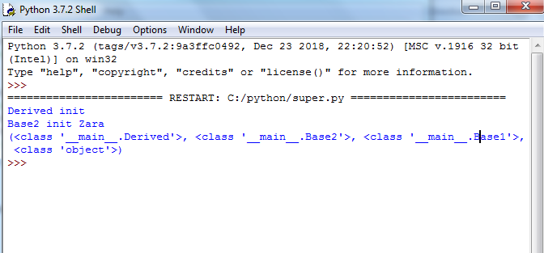
Output

Slide 38
Data Encapsulation
Encapsulation is the packing of data and functions operating on that data into a single component and restricting the access to some of the object's components.
Encapsulation means that the internal representation of an object is generally hidden from view outside of the object's definition.

Slide 39
class A:
def __init__(self,a,b,c):
self.var1=a
self._var2=b
self.__var3=c
ob=A(3,4,5)
print(ob.var3)

Slide 40
__Private and _Protected
class studentdata():
def __init__(self):
self._name="Zara"
self.__age=10
def putdata(self):
print(self.name)
print(self.age)
s=studentdata()
s.putdata()

Slide 41
Instance variable names starting with two underscore characters cannot be accessed from outside of the class. At least not directly, but they can be accessed through classname.
That means, private data __A can be accessed by the following name construct: instance_name._classname__A.

Slide 42
class A:
def __init__(self,a,b,c):
self.var1=a
self._var2=b
self.__var3=c
ob=A(3,4,5)
print(ob._A__var3)

Slide 43
Method Overloading
class studentdata():
def print1(self,a):
print("print1",a)
def print1(self,a,b):
print("print2",a,b)
s=studentdata()
s.print1(2,3)
s.print1(2)

Slide 44
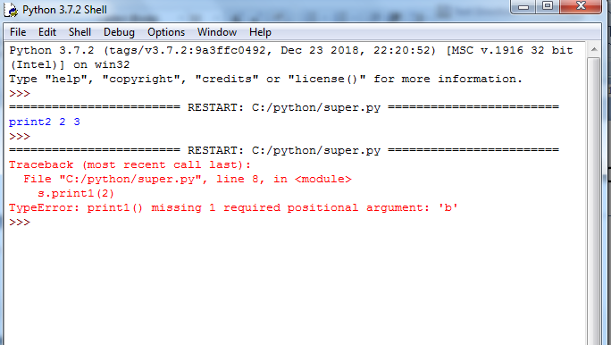

Slide 45
Method Overriding
class A:
def print1(self):
print("print1")
class B(A):
def print1(self):
print("print2")
b1=B()
b1.print1()

